Slide 1
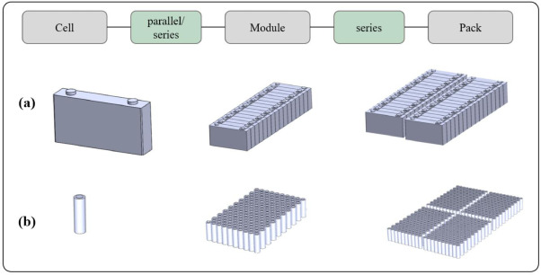
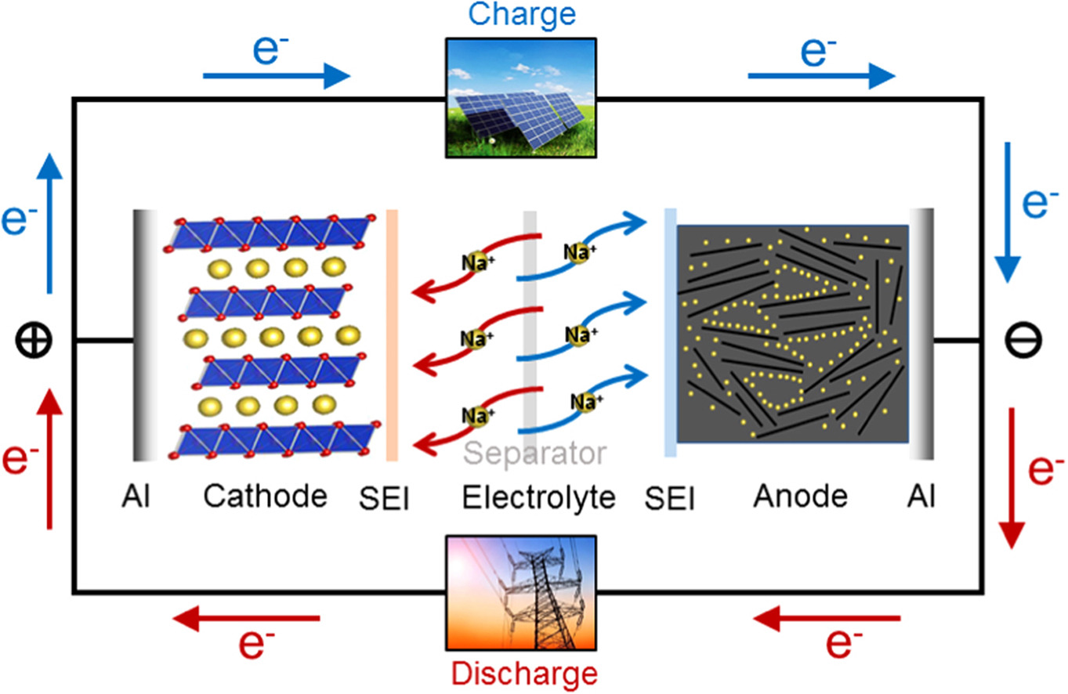
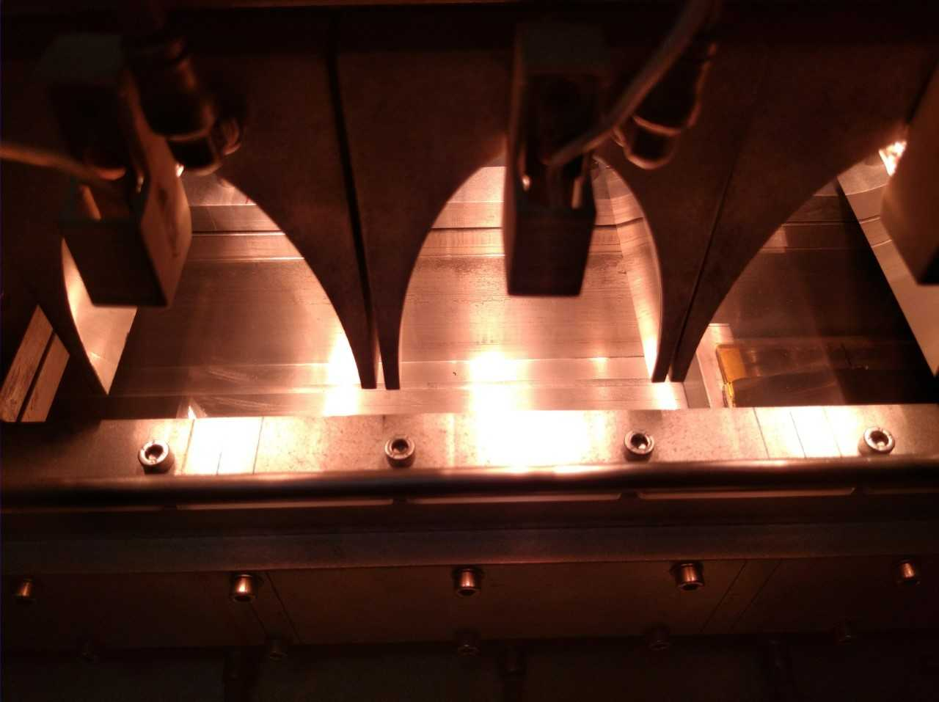
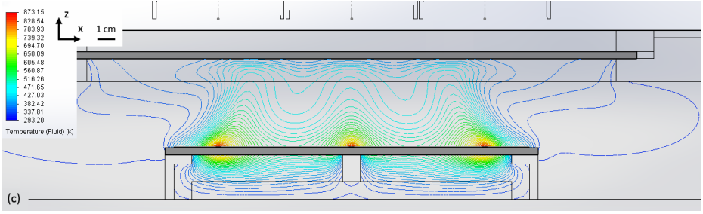
Master thesis topics in Energy and Environmental Engineering
29th September 2022
T11 – Thermal performance and mass flows in a system used to fabricate silicon electrodes for batteries
Supervision:
Guilherme Gaspar (gmgaspar@fc.ul.pt)
Jorge Correia (jmcorreia@fc.ul.pt)
Ivo Costa (imtcosta@fc.ul.pt)
Develop experimental procedures for the thermal characterization of a system used for manufacturing electrodes for lithium-ion batteries;
Perform computational fluid dynamics simulations for the system using dedicated software (SOLIDWORKS);
Optical and electrical characterization of calibration substrates.

Slide 2
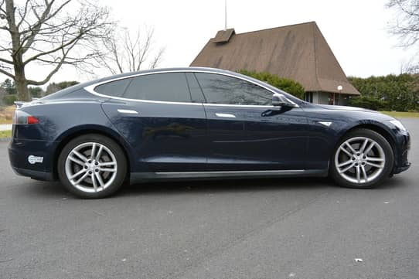
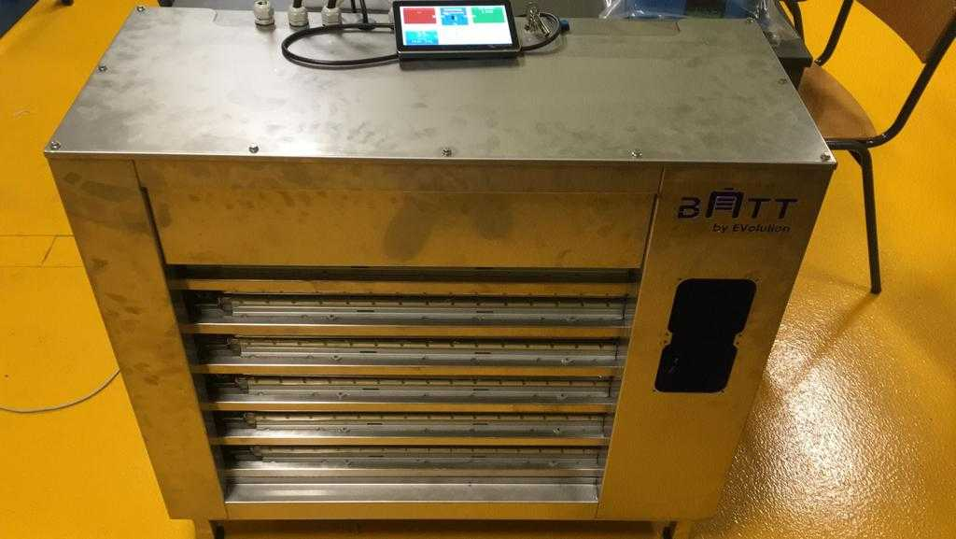
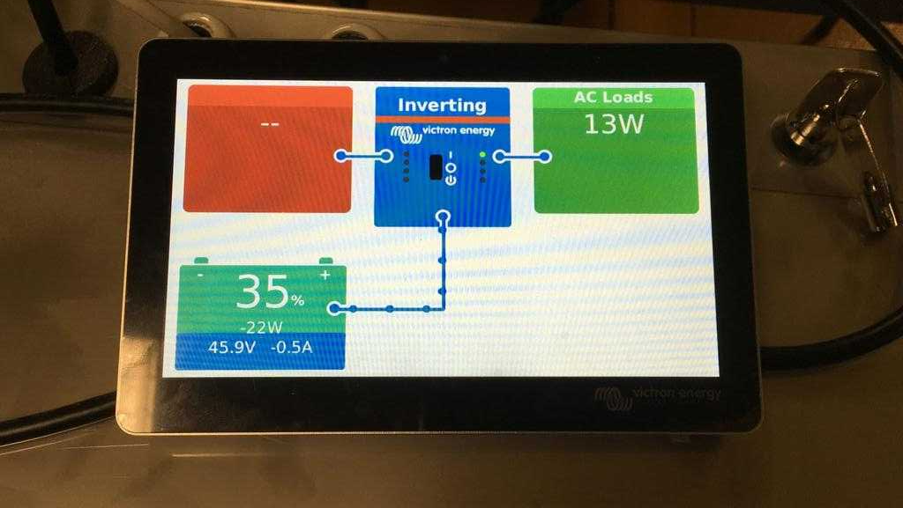
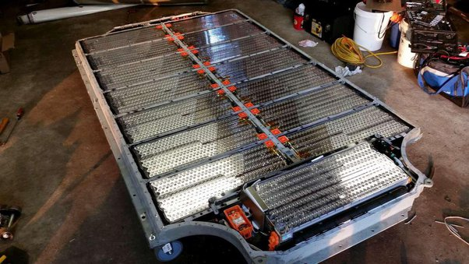
Master thesis topics in Energy and Environmental Engineering
29th September 2022
T12 – Performance analysis of a second-life battery bank
Supervision:
Guilherme Gaspar (gmgaspar@fc.ul.pt)
Ivo Costa (imtcosta@fc.ul.pt)
Miguel Brito (mcbrito@fc.ul.pt)
Collaborate in installing a battery bank from an EV at FCUL campus;
Develop communication protocols with the battery management system to obtain electrical and thermal data in real-time;
Charge batteries under a modular regime and evaluate potential degradation mechanisms.

Slide 3
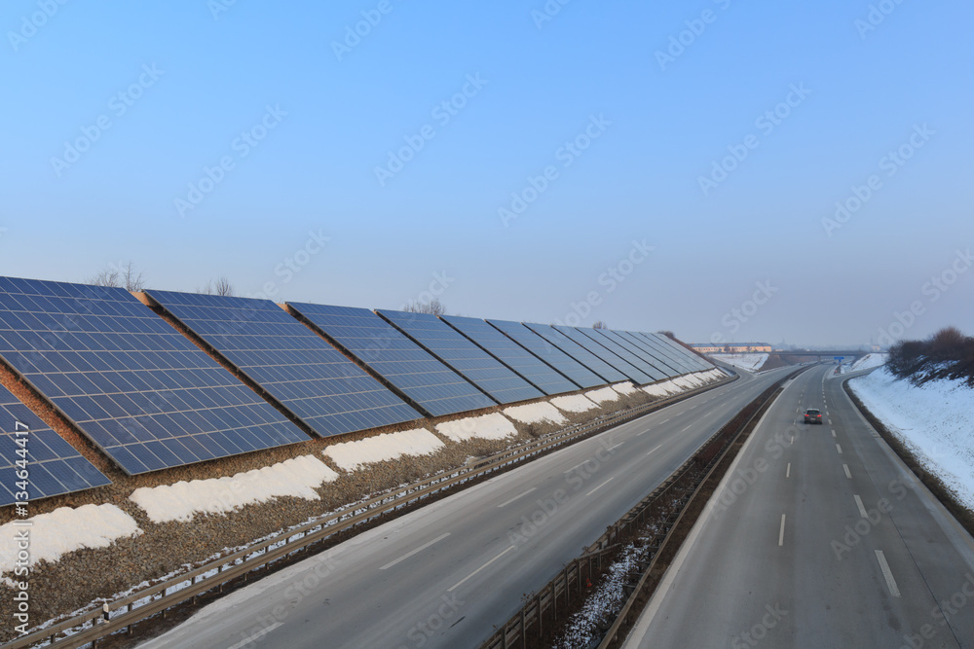
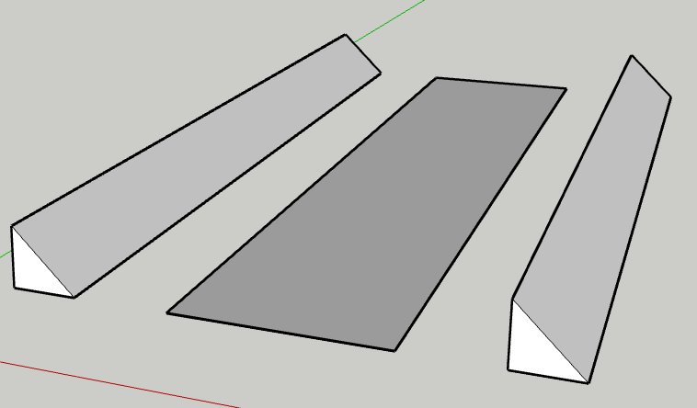
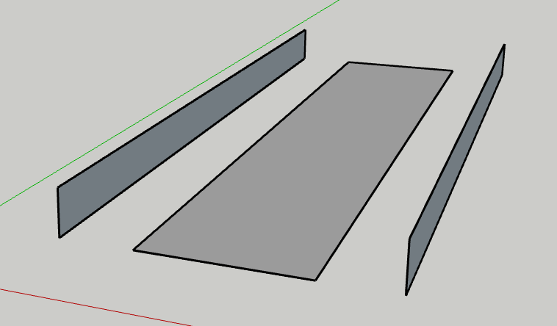
Master thesis topics in Energy and Environmental Engineering
29th September 2022
T21 – Solar potential of highways
Supervision:
Miguel Brito (mcbrito@fc.ul.pt)
Guilherme Gaspar (gmgaspar@fc.ul.pt)
Cristina Catita (cmcatita@fc.ul.pt)
Evaluate the solar potential of the Portuguese highways (geometry, extension, constrains, etc.) using ArcGIS and PVGIS;
Estimate consumption of service stations and compare it with generation;

